Slide 1

Let’s begin with
Programming!!!

Slide 2

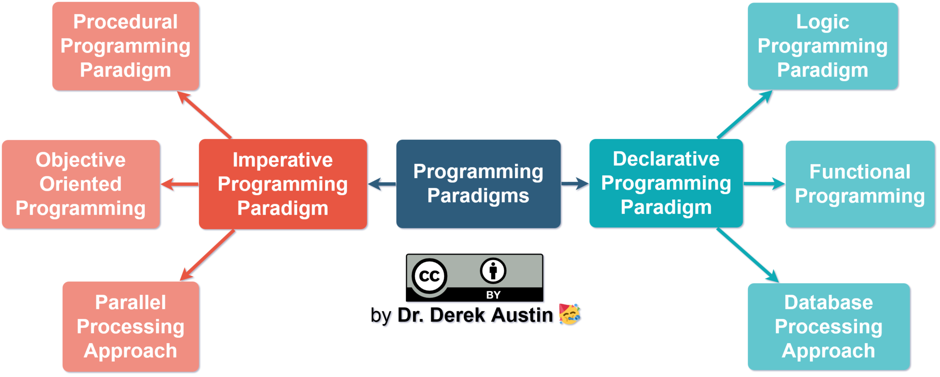
Programming paradigm [An approach to solve a problem using programming languages ]
Let’s start!!

Slide 3
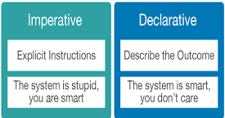
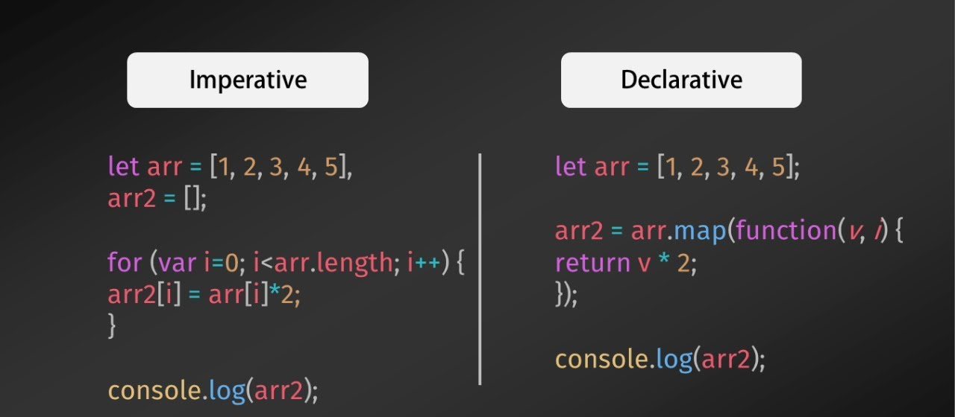
Imperative programming
(How to do)
It is one of the oldest programming paradigm. It features close relation to machine architecture. It performs step by step task by changing state. The main focus is on how to achieve the goal. The paradigm consist of several statements.
Declarative programming
(What to do)
It expresses the logic of a computation without describing its control flow. The focus is on what needs to be done rather how it should be done basically emphasize on what code is actually doing.

Slide 4
Declarative Programming (Quick overview)
Logical Programming- It can be termed as abstract model of computation. It would solve logical problems like puzzles, series etc. In logical programming the main emphasize is on knowledge base and the problem. E.g.- Prolog.
Functional Programming- The functional programming paradigms has its roots in mathematics and it is language independent. The central model for the abstraction is the function which are meant for some specific computation and not the data structure. E.g.- JavaScript, Erlang, ML.
Database Programming- This programming methodology is based on data and its movement. Program statements are defined by data rather than hard-coding a series of steps. E.g.- SQL.

Slide 5
Imperative Programming (Quick overview)
Procedural Programming- This paradigm emphasizes on procedure in terms of under lying machine model. It consists of a set of functions which perform a specific operation. E.g.- C, Pascal, C++.
Object Oriented Programming- The program is written as a collection of classes and object which are meant for communication. The smallest and basic entity is object and all forms of computation is performed on the objects only. It can handle almost all kind of real life problems which are today in scenario. E.g.- Java, C++, Python
Procedural Programming- Parallel processing is the processing of program instructions by dividing them among multiple processors. A parallel processing system posses many numbers of processor with the objective of running a program in less time by dividing them. E.g.- NESL

Slide 6
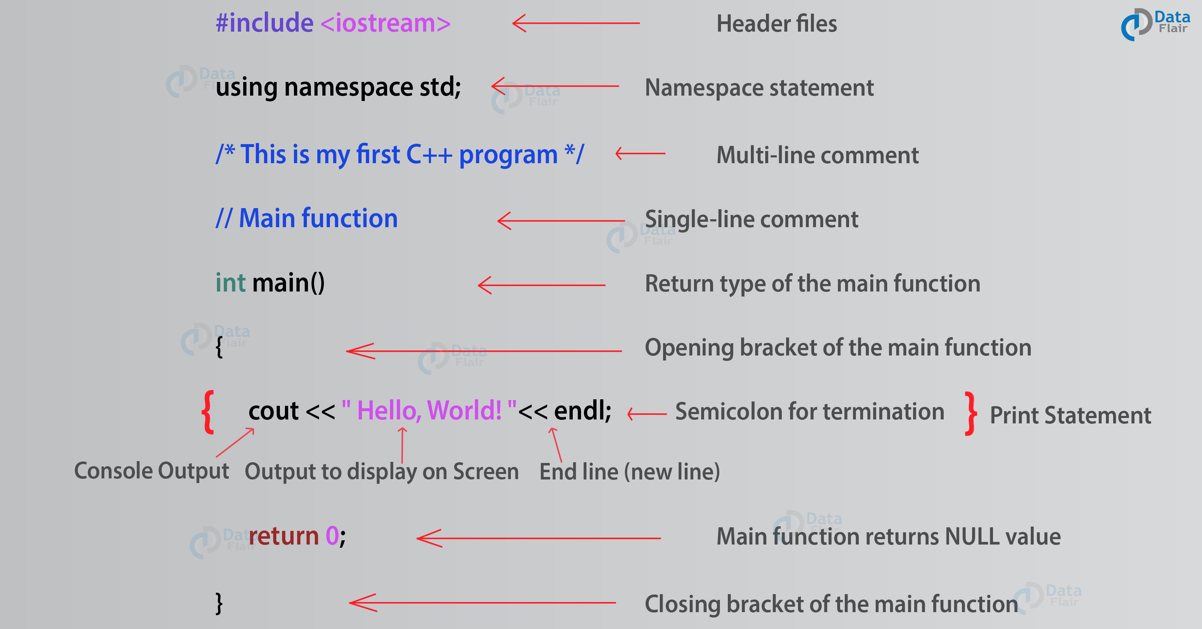
Basic C++ syntax for absolute beginners
#include <iostream> is a header file library
that lets us work with input and output objects, such as cout.
using namespace std means that we can use names for objects and variables from the standard library.
int main() is called a function. Any code inside its curly brackets {} will be executed.
cout (pronounced "see-out") is an object used together with the insertion operator (<<) to output/print text. In our example it will output "Hello World".
Every C++ statement ends with a semicolon ;
return 0 ends the main function.

Slide 7
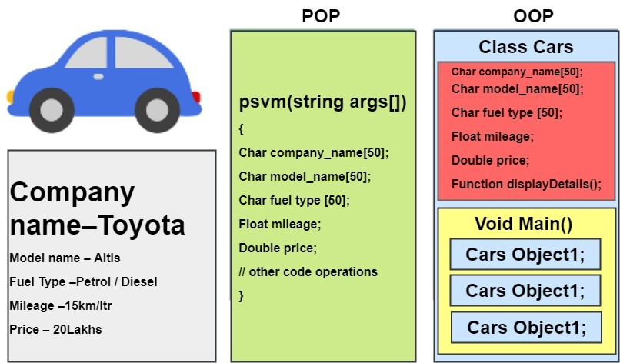
Object –Oriented programming
OOPs share some common features with non-OOPs namely:
Variables which store information in the format of either primitive datatypes (int, char, Boolean, etc.) or non-primitive datatypes (array, string, data structure etc.).
Procedures also known as functions which can take input, generate output and manipulate data.
What distinguishes them from POP is the use of classes and objects!

Slide 8
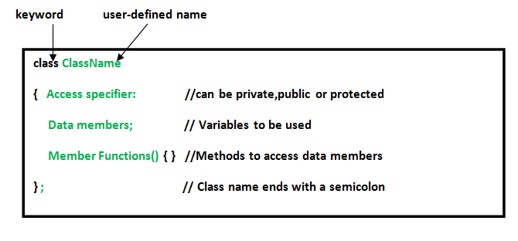
Classes and objects
A class is a user-defined data-type which has data members (variables) and member functions (to manipulate the data members). It can be accessed by creating an instance of the class. These instances created are called objects of that class.
When a class is defined, no memory is allocated but when it is instantiated (i.e. an object is created) memory is allocated.

Slide 9
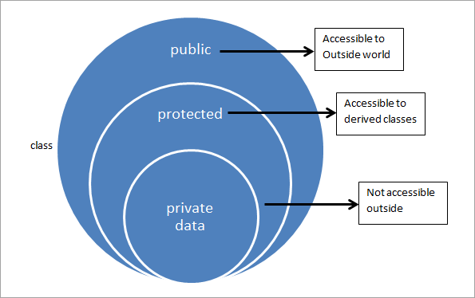
Access Specifier
Access specifiers define how the members (attributes and methods) of a class can be accessed. In C++ there are 3 access specifiers:
public- members are accessible from outside the class
private- members cannot be accessed (or viewed) from outside the class
protected- members cannot be accessed from outside the class, however, they can be accessed in inherited classes.

Slide 10
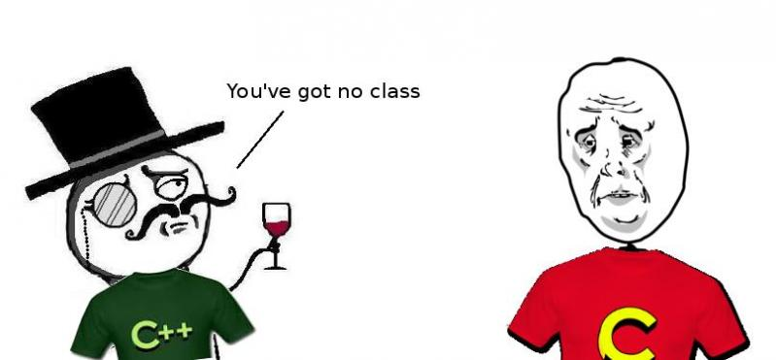
Why is C sad for not having classes like C++ when it has data structures? Both of them have similar functions, don’t they??!!

Slide 11
Differences between class and structure
In C++, a structure is the same as a class except for a few differences. The most important of them is security. A Structure is not secure and cannot hide its implementation details from the end-user while a class is secure and can hide its programming and designing details.
Members of a class have private access specifier by default and members of a structure are public by default.
Class can have null values but the structure can not have null values.
Class requires constructor and destructor but the structure does not require it.
Classes support polymorphism and also be inherited but the structure cannot be inherited.
Class is a reference type and its object is created on the heap memory whereas structure is a value type and its object is created on the stack memory.
Classes are fit for larger or complex objects in programs and Structs are good for small, isolated model objects!

Slide 12
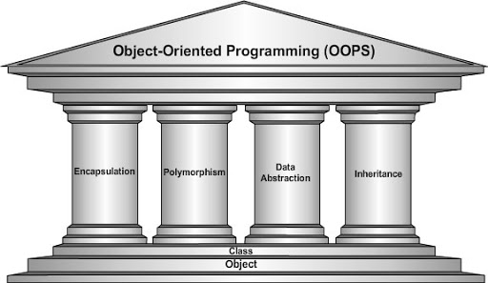
The 4 pillars of OOP (exclusive Features):
Encapsulation
Abstraction
Inheritance
Polymorphism

Slide 13
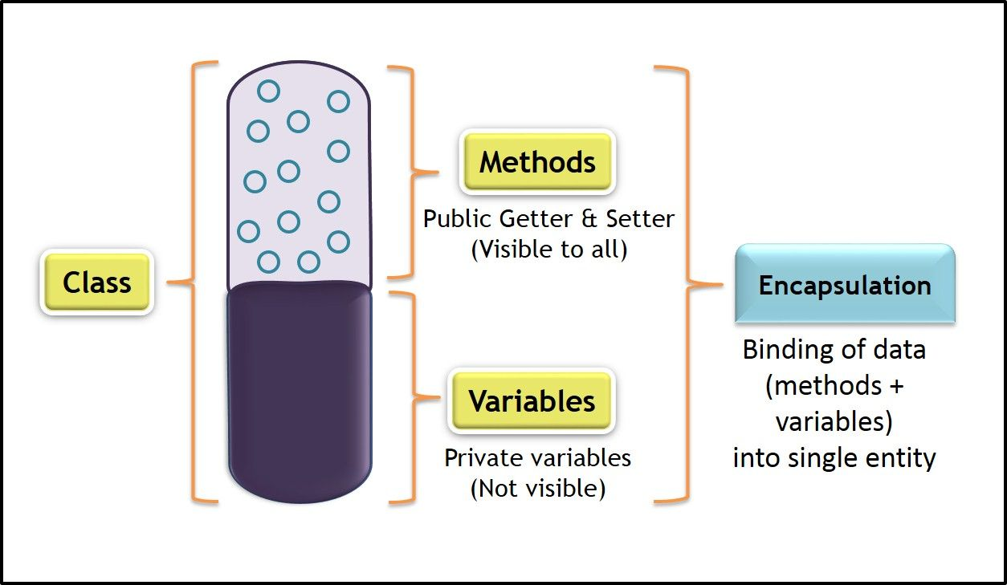
Encapsulation
It is a process of binding data members and member functions into a single unit. Basically, encapsulation is the process of wrapping up the data and functions in a single capsule.
If we take a real-world example of college, we have different departments like Physics, Chemistry, and Biology, etc. A situation may arise where in, the Head of the Physics department need some information from the Biology department, he can’t access the data from that department directly. First, he should contact the Head of the Biology department, then request him to give the data. This is how encapsulation works.

Slide 14
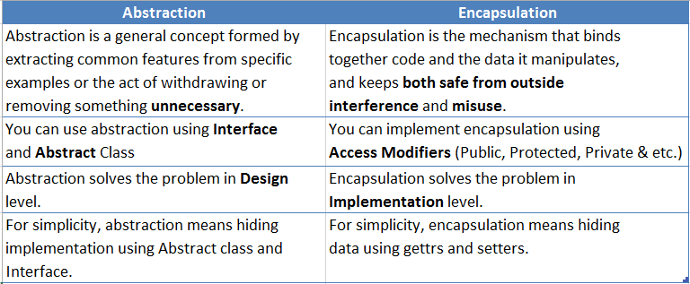
Abstraction
Abstraction is one of the most distinctive features of C++. Data abstraction concept in C++ helps programmers to provide only essential information to the outside world while hiding background details. It’s the most widely used technique that relies on the separation of implementation and interface of the code. Data Abstraction helps the user to increase the flexibility of the code while minimizing the problems and issues.
What are the differences between Abstraction and Encapsulation?

Slide 15
Implementing abstraction in a simple program
#include <iostream> using namespace std ; class abstract // declaring class { private : int x , y ; // private variables x and y public : // method to set values of all the declared private members void set ( int a , int b ) // declaring public function set { x = a ; y = b ; } void display () // declaring display() function { cout << " x = " << x << endl ; cout << " y = " << y << endl ; } } ; int main () { abstract obj ; // creating object of declared class obj.set ( 110 , 250 ) ; obj.display () ; return 0 ; }
Output:
x= 110
y= 250

Slide 16
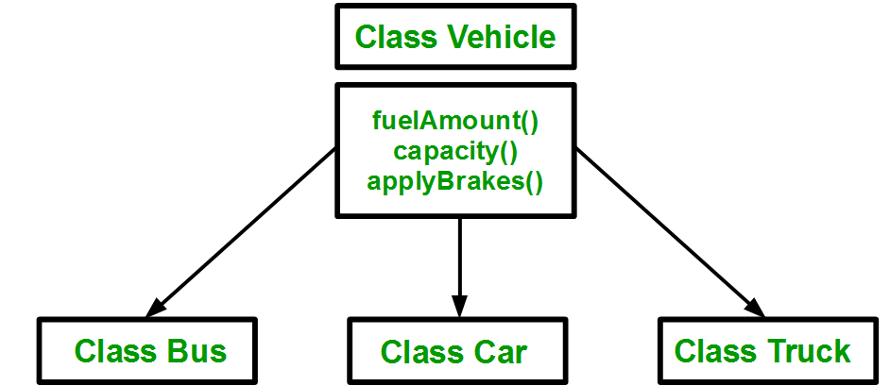
Inheritance
Inheritance is the process to create new classes or subclasses from an existing class. The existing class is called the parent class, and the derived class is called sub-class or inherited class. The inherited class have the behavior of parent class, and in addition, can have its own characteristics.
Consider a group of vehicles. You need to create classes for Bus, Car and Truck. The methods fuelAmount(), capacity(), applyBrakes() will be same for all of the three classes. If we create these classes avoiding inheritance then we have to write all of these functions in each of the three classes. But the process results in duplication of same code 3 times. This increases the chances of error and data redundancy. To avoid this type of situation, inheritance is used. We create a class Vehicle and write these three functions in it and inherit the rest of the classes from the vehicle class to access these methods and also add distinct additional features of the individual classes.

Slide 17
Modes of Inheritance:
Types of Inheritance:
// C++ Implementation to show that a derived class
// doesn’t inherit access to private data members.
// However, it does inherit a full parent object
class A
{
public:
int x;
protected:
int y;
private:
int z;
};
class B : public A
{
// x is public
// y is protected
// z is not accessible from B
};
class C : protected A
{
// x is protected
// y is protected
// z is not accessible from C
};
class D : private A // 'private' is default for classes
{
// x is private
// y is private
// z is not accessible from D
};
1. Single Inheritance: In single inheritance, a class is allowed to inherit from only one class. i.e. one sub class is inherited by one base class only.
2. Multiple Inheritance: Multiple Inheritance is a feature of C++ where a class can inherit from more than one classes. i.e one sub class is inherited from more than one parent classes.
3. Multilevel Inheritance: In this type of inheritance, a derived class is created from another derived class.
4. Hierarchical Inheritance: In this type of inheritance, more than one sub class is inherited from a single parent class. i.e. more than one derived class is created from a single base class.
5. Hybrid (Virtual) Inheritance: Hybrid Inheritance is implemented by combining more than one type of inheritance. For example: Combining Hierarchical inheritance and Multiple Inheritance.

Slide 18
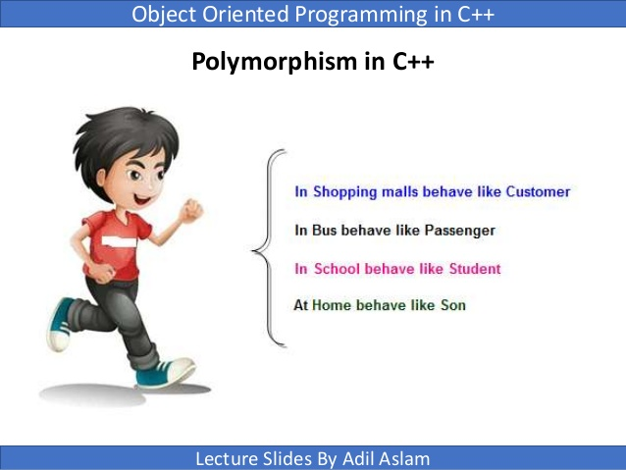
Polymorphism
We can define polymorphism as the ability of a message to be displayed in more than one form. Polymorphism occurs due to inheritance. Polymorphism often saves you from the unnecessary creation of new functions with similar functionality but a different number of arguments or inputs.
A real-life example of polymorphism, a person at the same time can have different characteristics. Like a man at the same time is a father, a husband, an employee. So the same person posses different behavior in different situations. This is called polymorphism.

Slide 19
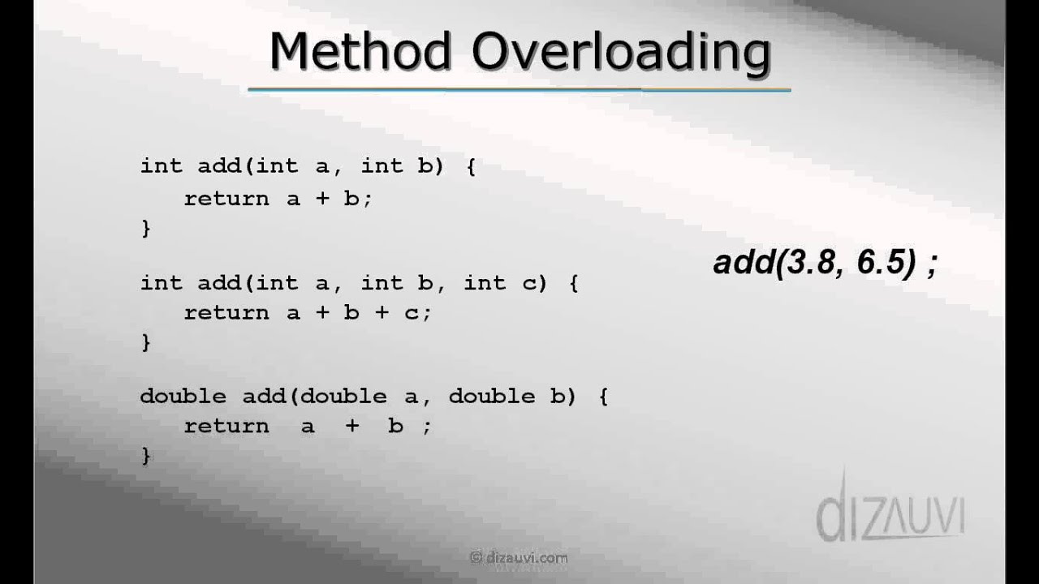
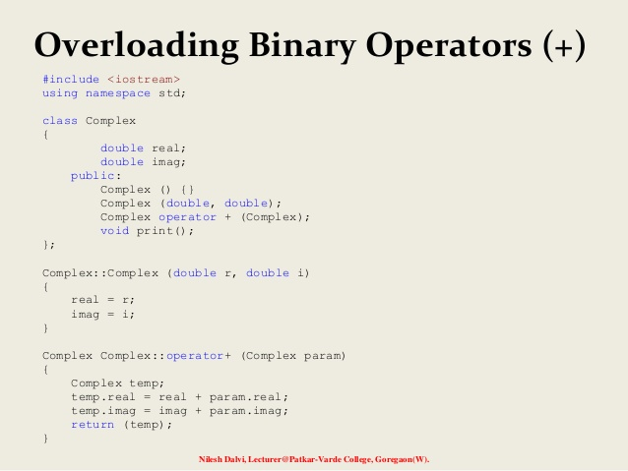
Compile time polymorphism
1) Function Overloading- When there are multiple functions with same name but different parameters then these functions are said to be overloaded. Functions can be overloaded by change in number of arguments or change in type of arguments.
2) Operator Overloading- C++ also provide option to overload operators. For example, we can make the operator (‘+’) for string class to concatenate two strings. We know that this is the addition operator whose task is to add two operands. So a single operator ‘+’ when placed between integer operands , adds them and when placed between string operands, concatenates them.

Slide 20
Runtime polymorphism
// C++ program for function overriding
#include <iostream.h>
using namespace std;
class base
{
public:
virtual void print ()
{ cout<< "print base class" <<endl; }
void show ()
{ cout<< "show base class" <<endl; }
};
class derived: public base
{
public:
void print () //print () is already virtual function in derived class,
we could also declare it as virtual void print () explicitly
{ cout<< "print derived class" <<endl; }
void show ()
{ cout<< "show derived class" <<endl; }
};
//main function
int main()
{
base *bptr;
derived d;
bptr = &d;
//virtual function, binded at runtime (Runtime polymorphism)
bptr->print();
// Non-virtual function, binded at compile time
bptr->show();
}
Function Overriding- When a derived class has a definition for one of the member functions of the base class. That base function is said to be overridden.
Output:
print derived class
show base class
New keyword: “virtual”
Let’s have a look!

Slide 21
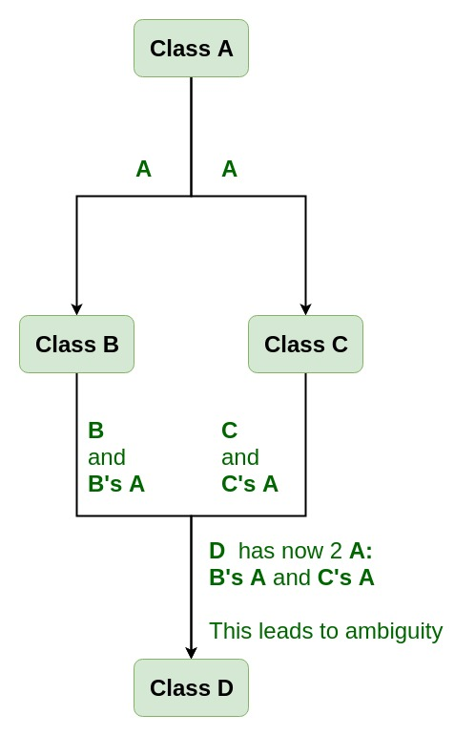
Virtual functions
What is a virtual function?
A virtual function is a member function which is declared within a base class and is re-defined (Overridden) by a derived class. When you refer to a derived class object using a pointer or a reference to the base class, you can call a virtual function for that object and execute the derived class’s version of the function.
Why or when do we use a virtual function?
Virtual functions are used in virtual inheritance in a way of preventing multiple “instances” of a given class appearing in an inheritance hierarchy when using multiple inheritances.
Consider the situation where we have one class A .This class is A is inherited by two other classes B and C. Both these class are inherited into another in a new class D as shown in figure. As we can see from the figure that data members/function of class A are inherited twice to class D. One through class B and second through class C. When any data / function member of class A is accessed by an object of class D, ambiguity arises as to which data/function member would be called? One inherited through B or the other inherited through C. This confuses compiler and it displays error. These issues can be solved by using virtual functions feature of OOP.

Slide 22
Abstract Class
What is an abstract class?
By definition, an abstract class in C++ is a class that has at least one pure virtual function. The classes inheriting the abstract class must provide a definition for the pure virtual function; otherwise, the subclass would become an abstract class itself.
Properties of Abstract Class:
1) Abstract class cannot be instantiated, but pointers and references of Abstract class type can be created.
2) Abstract class can have normal functions and variables along with a pure virtual function.
3) Classes inheriting an Abstract Class must implement all pure virtual functions, or else they will become Abstract too.
4) An abstract class can have constructors.

Slide 23
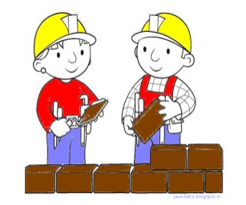
Constructor and Destructor
Constructors
A constructor is a member function of a class that has the same name as the class name. It helps to initialize the object of a class. It can either accept the arguments or not. It is used to allocate the memory to an object of the class. It is called whenever an instance of the class is created. It can be defined manually with arguments or without arguments. There can be many constructors in class. It can be overloaded but it can not be inherited or virtual.
Destructors
Like constructor, destructor is also a member function of a class that has the same name as the class name preceded by a tilde(~) operator. It helps to deallocate the memory of an object. It is called while object of the class is freed or deleted. In a class, there is always a single destructor without any parameters so it can’t be overloaded.

Slide 24
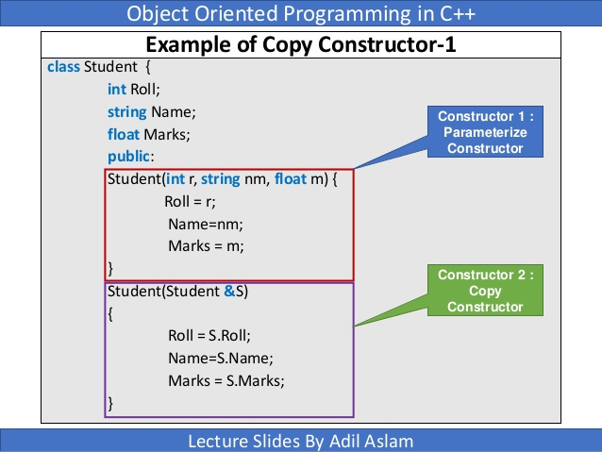
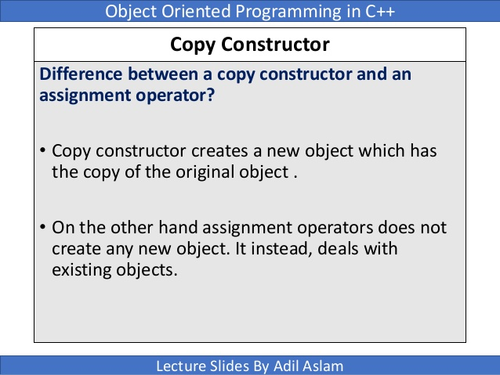
Copy Constructor
Copy constructor is a special type of constructor used to create the copy of an object of the class. This constructor accepts an object of the same class as arguments and copies it to another object of the class being created. If not explicitly mentioned, the compiler creates a copy constructor!

Slide 25

Garbage Collection in C++
Garbage collection is a memory management technique. It is a separate automatic memory management method which is used where manual memory management is not preferred or done. In the manual memory management method, the user is required to mention the memory which is in use and which can be deallocated, whereas the garbage collector collects the memory which is occupied by variables or objects which are no more in use in the program. Only memory will be managed by garbage collectors, other resources such as destructors, user interaction window or files will not be handled by the garbage collector.
One major disadvantage of garbage collection is the time involved or CPU cycles involved to find the unused memory and deleting it, even if the user knows which pointer memory can be released and not in use. Another disadvantage is, we will not know the time when it is deleted nor when the destructor is called.
This algorithm can be implemented in C++ using a specific pointer type. A specific pointer type should be declared and this can be used for purposes such as keeping track of all the references created, keeping track of the reference count when reference is created and deleted. A C++ program can contain both manual memory management and garbage collection happening in the same program. According to the need, either the normal pointer or the specific garbage collector pointer can be used.

Slide 26
Final Comparison!
Procedural Programming | Object Oriented Programming
It focuses on the process and functions. | It focuses on the data and classes.
In this paradigm, if a sub-procedure has to be modified, it becomes difficult to find and maintain it. | In this paradigm, it is easy to maintain code and modify existing code.
Data hiding is not possible. | Data hiding is possible, hence more secure than procedural.
Operator overloading is not allowed. | In OOP, operator overloading is allowed.
It has no such concepts like Inheritance. | It has four main concepts – Abstraction, Encapsulation, Inheritance, and Polymorphism.
Procedural uses procedures, modules, procedure calls. | Object-oriented uses objects, classes, messages.
Due to its complexity, development time increases. | Due to easy maintenance, development time reduces.
Procedural programming languages are not as faster as object-oriented. | The object-oriented programming languages are faster and more effective.

Slide 27

Both the approaches are good to go and depends upon an individual or team which approach they prefer. Object-oriented and procedural are high-level programming paradigms to solve problems in less time by writing modular code. But OOP is best when it comes to bigger applications as procedural is not good for complex applications.

